Slide 1
The Tank Game
A Final Project Presentation
Prepared By:
Bishruti Siku
Nitish Dhaubhadel
Iksha Gurung
Pranaya Pradhananga
Sandip Sahani

Slide 2
About Project

Slide 3
Concept of Game
Derived from Nintendo’s 1980 console game “BATTLE CITY”
Has four players, two players form a team.
Each team has seal to defend.
Main objective of the game, destroy enemy seal.
Game has 13 different levels to play.

Slide 4
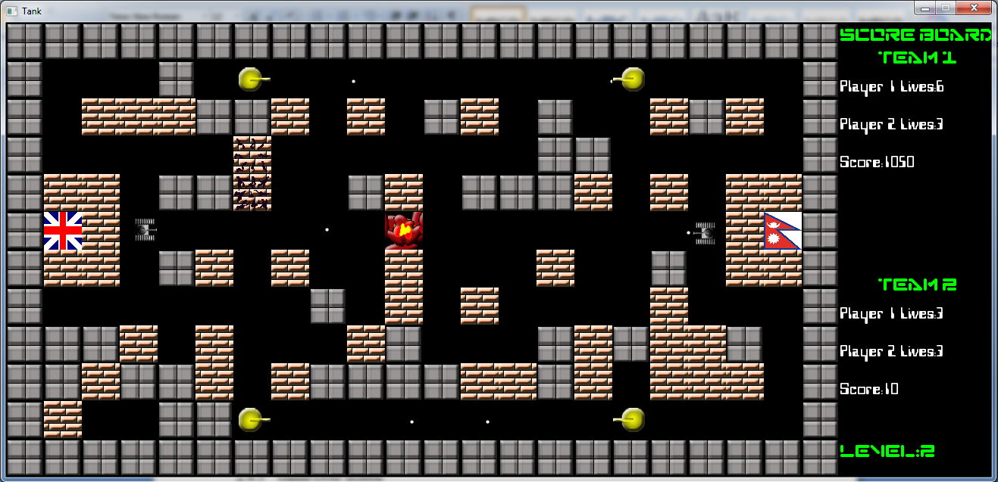
Snapshot of the Game
Fig : Snapshot of the main game screen.

Slide 5
Project Implementation

Slide 6



Resources used
Resources Used | For
Dev Cpp 4.9.9.2 | A free open source IDE based C/C++ Compiler
Simple Direct media Layer(SDL) | A free open source game development library programmed in C
Microsoft Paint, Macromedia Flash and Adobe Photoshop | Design of Game Graphics
Abyss Wave Editor | Designing and Editing game music and sound effects

Slide 7
Implementation Overview
Level initialization
Collision detection
User Interface
Score management

Slide 8
Overview
Level Initialization

Slide 9
Overview : Level Initialization
Information for each level is stored in level information file.
Programs read level information for each level from file.
Information for level is stored in numeric representation for each game element.
Includes 13 level, flexibility for adding new levels.

Slide 10
Overview : Level Initialization
Flowchart : Reading file information from file
Start
Get level number
Open Level File
While !EOF
Read characters from file
Assign element to cell
Yes
No
Close level file
End

Slide 11
Collision Detection
Overview

Slide 12
Overview : Collision Detection
Collision detection was the most difficult part of the game
Implements a general collision detection algorithm
Used for Inter-player collision, bullet collision, wall collision etc.
Makes use of SDL_Rect structure that hold x and y coordinates and width and height of objects.

Slide 13
Overview : Collision Detection
Flowchart : Collision detection
Start
Get two objects obj1 and obj 2
Obj1.x+ w < Obj2.x
Obj1.x > Obj2.x+ w
Obj1.y+ h < Obj2.y
Obj1.y < Obj2.y + h
Determine offsets of each objects
No
No
No
No
Yes
Yes
Yes
Yes
No Collision
End
Collision Detected

Slide 14
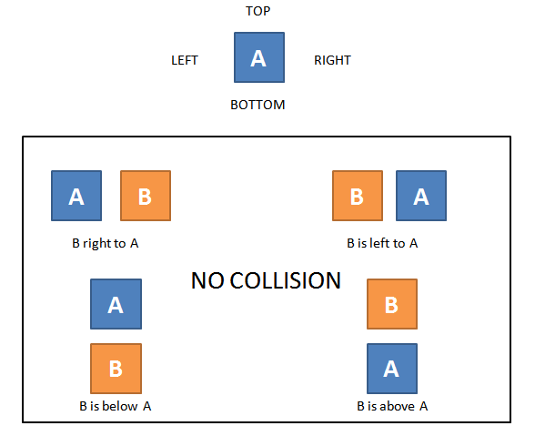
Overview : Collision Detection
Fig: Diagrammatic representation of collision detection

Slide 15
Overview
User Interface

Slide 16
Overview : User Interface
User interface is essential part of the game.
Welcome screen greets the player before the main game.
Main welcome screen provides user with five options
Play game
Option
Hall of Fame
Credits
Exit

Slide 17
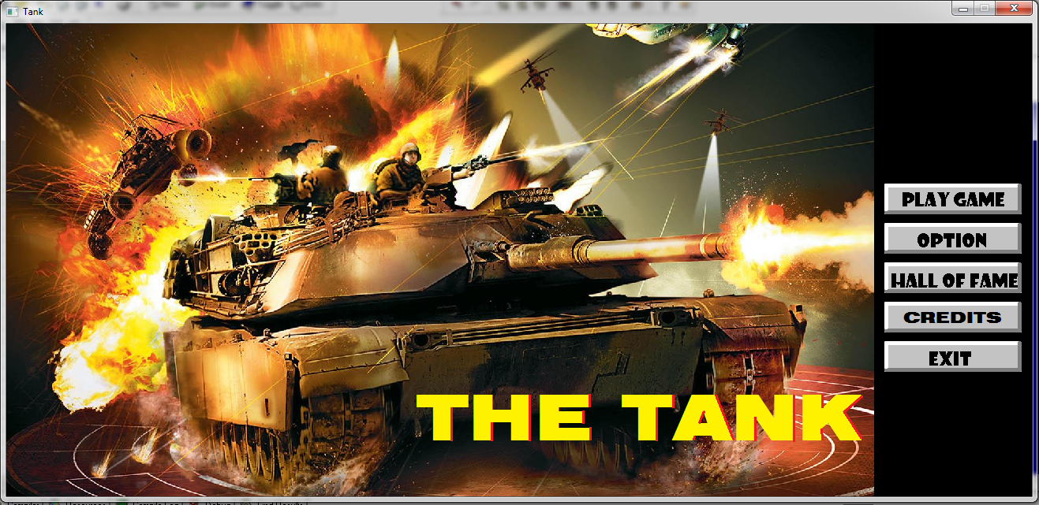
Overview : User Interface
Snapshot
Fig : Main welcome screen of the game

Slide 18
Overview
Score Management

Slide 19
Overview : Score Management
Score management implemented through simple file handling
Only top 10 scores are stored.
Score of only the team that makes a high score is stored.
Scores are stored in file in games Scores directory and can be viewed in game by clicking “Hall of Fame” button in main game screen.
Scores are sorted using Bubble sorting algorithm

Slide 20
Overview : Score Management
Flowchart : Saving high scores to file
Start
Get score
Score > Minimum
Open Level File
Write the score to file
Yes
No
End
Close level file

Slide 21
Conclusion
Project was successful completed in time.
Learned essential skill related to team work, programming in C.
Very thankful to all helping hands and beautiful minds who contributed to the project.
Future Prospect:
Add enemy with AI.
Enable network based game play.
Add more interesting features to game like multi-team play, points, special effects etc.

Slide 22
Thank You
Any suggestion or question?

